Slide 1
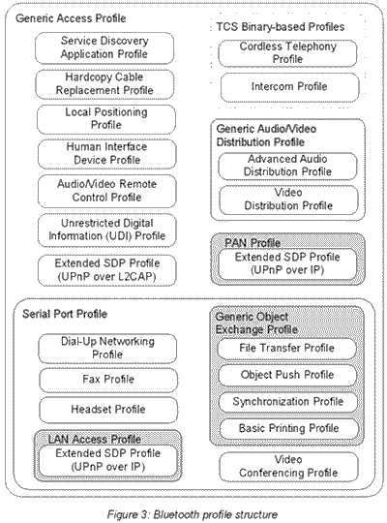
Bluetooth Cheat Sheet v1.0
Definitions
A wireless technology with open specification for a low-cost, low-power, short range radio technology with 2 main priorities: cheap, and low energy.
- Invented by Ericsson in 1994, the Bluetooth SIG was founded in 1998 with 4 members: IBM, Intel, Nokia, Toshiba. Today has more than 2000 members.
- Usage: PAN, ad-hoc networks, data/voice comms, wireless telematics
- Operates at 2.4Ghz ISM Band, frequency hopping in spectrum [2.402 – 2.480] GHz
- Profiles: are additional protocols that defines what kind of data a Bluetooth module is transmitting. While Bluetooth specifications define how the technology works, profiles define how it’s used.
- Qualifications: interoperability, no license, no LOS, auto ad-hoc network.
Versions
v2.1 2007 | + Enhanced Data Rate, basic pairing (button press, numerical pair), speed up to 3Mps
v3.0 2009 | + High Speed, uses 802.11 (a,b,g,n) to send data, speed up to 24 Mbps.
v4.0 2010 | + Low Energy, speed more than 24 Mbps.
v4.1 2013 | eliminates the interference of Bluetooth radio with 4G automatically, improves data transfer and smarter connectivity.
v4.2 2014 | introduces Low Energy data packet length extensions, Low Energy privacy upgrades and Low Energy secure connections.
Power | Distance | Energy
Class 1 | Long range, 100m | 20 dBm / 100mW
Class 2 | Mid range, 10m | 4 dBm / 1-2.5mW
Class 3 | Short range, 0.1-10m | 0 dBm / 1mW
Ad-hoc Networking
Piconet | Decentral, 1 master – 7 slaves | Point to point or multipoint
Scatter-net | Overlapping of 2 piconets (max 10), different hopping freqs | Peer 2 peer
Connection Process
Inquiry: discover others by discovery process.
Paging: forming connection between 2 devices.
Connection: enters connection state. 3 modes: Active – in transmission or receiving of data, Sniff – power-saving mode, regular sleep-wake at every X ms, Hold – instructed to sleep by master and wake up after certain interval, Park – deepest sleep mode, until Master tells to wake up.
Layers & their roles
Bluetooth Radio | Lowest defined layer
Baseband | Physical layer, controls: error, flow, hopping (79 channels), security. Has 3 connection modes: - STANDBY, ACTIVE and Power Saving Mode
Audio | 2 codecs: PCM & CVSD, both at 64kbps, using SCO links.
LMP (Link Manager Protocol) | authentication, link setup, acts as service provider, comm with LM PDUs
HCI (Host Controller Interface) | command interface, hardware status, can be via UART, RS232, or USB
L2CAP (Logical Link Control and Adaptation Protocol) | Establish connection (less/full) to upper layer. 2 links types are used: SCO (not supported by L2CAP), ACL (Async conn less)
RFCOMM (Radio Frequency Communication) | Emulation of serial ports, up to 60 simulaneous conns.
SDP (Service Discovery Protocol) | For discovery of services and their characteristics using request/response of one PDU each time.
Protocol Stack
Bluetooth Profile Structure
A2DP | Advanced Audio Distribution Profile Defines the streaming of high quality audio signal between devices (one way).
AVRCP | Audio/Video Remote Control Profile Defines the standard for remote control of TVs, Hifi, etc.
BIP | Basic Imaging Profile For sending (pull/push) images between devices with ability to resize, convert images.
BPP | Basic Printing Profile
DID | Device ID Profile Identifies device, manufacturer, product version, etc.
DUN | Dialup Networking Profile
Bluetooth Classic v/s Bluetooth 4.0 LE
IEEE Standard | 802.15.1 | 802.15.1
Frequency (GHz) | 2.4 | 2.4
Maximum raw bit rate (Mbps) | 1-3 | 1
Typical data throughput (Mbps) | 0.7-2.1 | 0.27
Maximum Range (Meters) | 10 (class 2), 100 (class 1) | 50
Relative Power Consumption | Medium | Very low
Example Battery Life | Days | Months to years
Network Size | 7 | Undefined
FTP | File Transfer Profile
GAVDP | General Audio/Video Distribution Profile – basis for A2DP and VDP.
GEOP | Generic Object Exchange Profile – based on OBEX
HFP | Hands-Free Profile – uses SCO to carry mono voice audio data.
HID | Human Interface Device Profile – input devices such as mouse, joysticks, keyboards, etc.
PAN | Personal Area Networking Profile
SDAP | Service Discovery Application profile

Slide 2
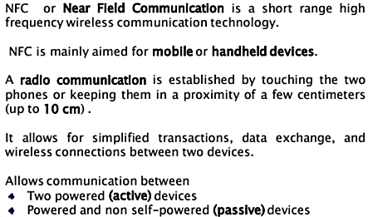
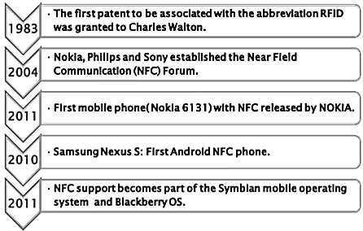
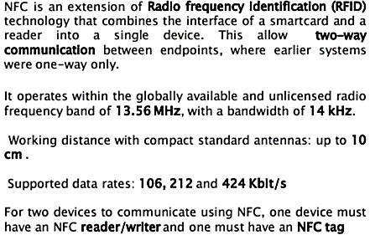
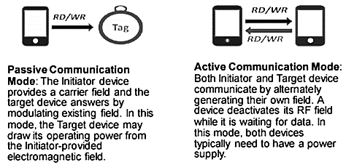
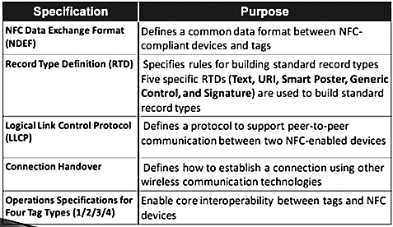
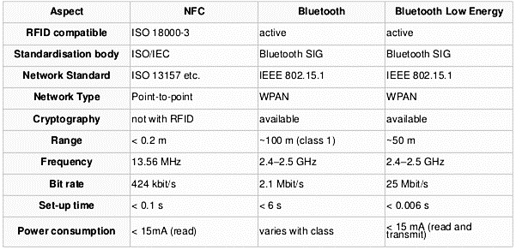
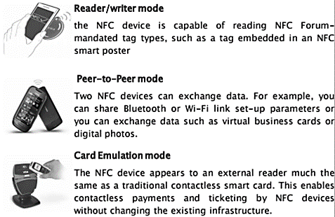
NFC Cheat Sheet – Part 1 v1.0
Definitions
History
Features
NFC Two Modes of Communication

Slide 3
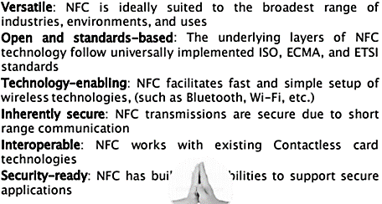
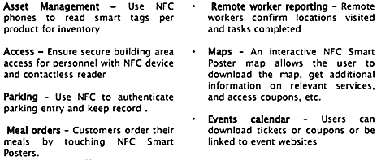
NFC Cheat Sheet – Part 2 v1.0
Benefits of NFC
Applications of NFC

Slide 4
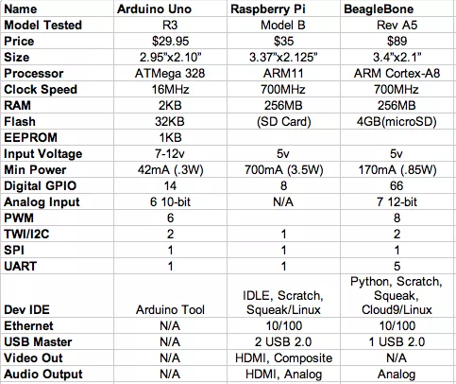
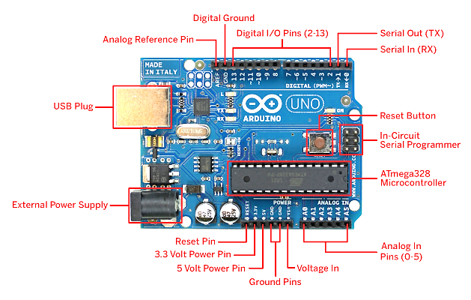
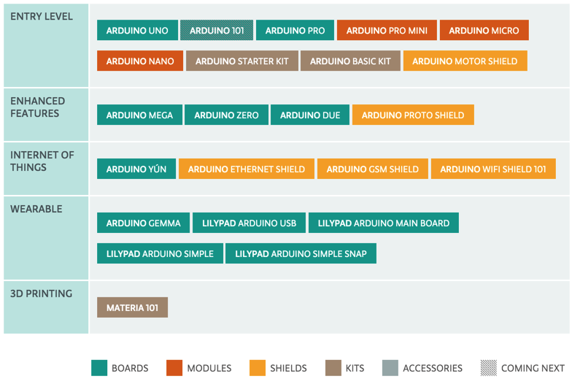
IoT Hardware Cheat Sheet v1.0
Arduino
Open-source hardware prototyping platform, powered by Arduino programming language (based on Wiring, o/s framework for microcontrollers) and Arduino IDE (based on Processing).
- Simple microcontroller, usually Atmel chip such as ATmega328, 8-6-32 Mhz.
- Programmed in C (i.e. sketches) in Arduino IDE, runs in loop (as embedded software)
- Operating at 3.3V or 5V, input voltage 6-20V
- Has digital pins (1/0), which can be used for both input and output. Some special pins such as PWM can vary the amount of time that it’s ON/OFF really fast so it can simulate an analog output signal.
- Has analog pins, which are mostly used for input, with a built-in A/D converter.
- Flash memory size 32KB, 64KB. ~0.5KB used by the bootloader.
- SRAM size 2KB, 4KB, 8KB depending on the processor.
Choosing IOT Hardware Device
Base on: Form Factor, Shape, Function, Dev/Design, Cost, and Manufacturability.
RFC 7228 defines 3 classes of device depending on RAM and flash memory size:
Class 0 | << 10 KiB | << 100 KiB
Class 1 | ~ 10 KiB | ~ 100 KiB
Class 2 | ~ 50 KiB | ~ 250 KiB
Famous microcontroller manufacturers: MicroChip, Atmel, Intel, Analog devices, etc.
Arduino UNO vs Raspberry Pi vs BeagleBone
IoT General HW Bus/Port Types
I2C | Easiest and most expandable bus, easy for programming.
SPI | Serial Peripheral Interface Limited number of devices, but fast, more difficult to programming
UART | RS-232, old I/O conn
GPIO | Good for turning on/off IO ports.
Arduino UNO Board Layout
Raspberry Pi
A credit card–sized single-board computers developed in the UK RPi Foundation to promote teaching of basic computer science in schools and developing countries.
- ARM-based processor, 700 MHz single-core ARM1176JZF-S (model A, A+, B, B+, CM), 900 MHz quad-core ARM Cortex-A7 (RPi 2)
- Linux/Unix Operating system, e.g. Raspbian, RISC OS, FreeBSD, NetBSD, Plan 9, Inferno, AROS
- 256 MB RAM (model A, A+, B rev 1), 512 MB (model B rev 2, B+, CM), 1 GB RAM (RPi 2)
- Storage uses SDHC slot (model A and B), Micro SDHC slot (model A+ and B+)
- Powerful Broadcom Video Core IV graphic card
- Power:1.5 W (model A), 1.0W (model A+), 3.5W (model B) or 3.0W (model B+), 4.0W (RPi 2)
- Networking: built-in USB Ethernet adapter (except model A/A+)
- Low-level I/O: GPIO: UART, I²C bus, SPI bus with two chip selects, I²S audio +3.3 V, +5 V, ground.
Arduino Devices Roadmap

Slide 5
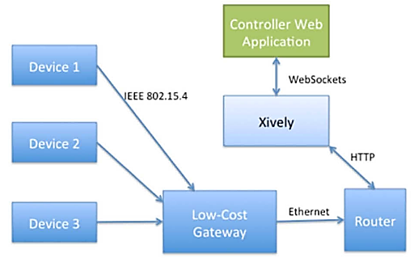
IoT Platforms Cheat Sheet – Part 1 v1.0
Xively
Xively is a PaaS for building connected IoT products, through Xively messaging platform, one can monitor the device signals, controls their status, integrates the input data with third party systems.
Xively Terminology
Activation Code | The code submitted to Xively by a device with Internet connectivity when the device powers on. A device creates its activation code by generating a HMAC-SHA1 ID, based on the serial number of the device and the product secret stored in the device’s firmware. The Activate Device API stores the activation code and activation date as attributes of the device in the database and returns the Feed_id and api_key to the device.
API Key | API Keys are used to control access to the resources via the API. An API key is a hierarchy of three objects: key, permission and resource. A key object contains one or more permissions objects, and a permissions object can optionally contain resource objects.
Channel | Every DataStream in the API is a two-way communications channel on the Xively platform. Channels are limited to 32 characters per Data point value.
Datapoint | A single value of a DataStream at a specific point in time. It is simply a key value pair of a timestamp and the value at that time.
Datastream | A bi-directional communications channel that is used for exchanging of data between Xively and authorized devices, applications, and services.
Device | Devices are individual, physical instances of a product. Each device in a batch of products is provisioned with a unique serial number which it uses to activate on the Xively service.
Environment / Feed | The collection of channels (data streams), defined for any given device. A Feed’s metadata can optionally specify location, tags, whether it is physical or virtual, fixed or mobile, indoor or outdoor, etc. Every device has exactly one Feed.
Frozen Feed | A Feed which was last updated more than 15 minutes ago.
Live Feed | The Feed was updated with data within the last 15 minutes.
Gateway | A gateway is a conceptual element of connected objects.
Historical Query | A query that returns a list of historical Data points within the specified range for one or more DataStream's.
Master Key | A master key is a non-resource restricted, private key, which has permissions to perform all HTTP methods.
Pre-registering | To pre-register a group of devices with Xively, use Xively Workbench to upload the serial numbers made available to you by the manufacturer. For each serial number uploaded, Xively uses the Create Device API to create the device in the database, setting the serial and the created_at attributes. So when a pre-registered device transmits its activation code to Xively, the API knows that these devices are authorized to be used on Xively.
Product Secret | A random hex string automatically generated when a product is created in the provisioning system. The product secret is used in the activation process.
Provisioning | The process whereby a physical device sharing a serial number with an inactive device defined in a product batch in Xively comes online, submits an activation code to Xively and receives its configuration information back so that the device can interact with and through Xively.
Resources | Xively exposes 7 resources via URLs (Uniform Resource Locators): Feeds, DataStream, Data points, Keys, Triggers, Products, and Devices. To access a Xively resource, you submit an HTTP request to one of the published URLs using the four HTTP verbs (DELETE, GET, POST, PUT) and indicating the format representation (JSON, XML, CSV).
Serial Number | a unique ID assigned to each device, accessible to the activation code running on the device. This ID can be a value generated and programmed into the device during the manufacturing process, or it can be a device specific identity such as a MAC address or processor serial number.
Location Waypoints | The collection of locations registered for a device whose disposition is mobile. You cannot delete or change waypoints.
Xively Setup
1. Setup Xively account.
2. Add New Device in Xively Developer Center. Xively Workbench will provide 2 important data: API Key: key used for CRUD resources on Xively, usually configured onto the Local Gateway or the device with direct Internet access. Feed ID: ID or URL used for client website/app to read device data, status, etc.
3. Create channels for the device. A channel represents an attribute or a characteristic of the device, for example the value of light sensitivity from a photo cell. Channels come with additional data such as: Location: allows adding location data to the channels manually (fixed location) or dynamically (devices can also send the location data itself) Metadata: specifies the creator of the feed, name, website, group, etc. Triggers: a kind of IFTTT for self triggering of own service or third-party services (base on the comparison result of the channel data). Request Log: for real-time debugging and monitoring of device.
3. Deploy – Add Product Batch and Product This action creates a batch of virtual products that will map to the physical devices. The mapping is done via the Serial Number of each device. The serial number can be added by uploading a CSV file or entering manually.
Wislab
Czech wireless laboratory, develops a visualization framework for sensor devices plugged in to Xively cloud.
SensMap Visualization Framework Visualize state of sensor devices Visualize location of sensor devices outdoor and in-building Manage devices’ location via interactive map or floor plan Report sensor values with graphs, and comparison reports Visualize wireless sensor topology and signal quality between nodes
Xively Featured Hardware Partners
eConais | Wireless modules manufacturer
mbed | Platform and OS for IoT devices based on 32-bit ARM Cortex-M
TST | System integrator providing customized wireless solutions
Arduino | Open-hardware prototyping platform
electric imp | Wi-Fi enabled development platform powered by Cortex M3

Slide 6
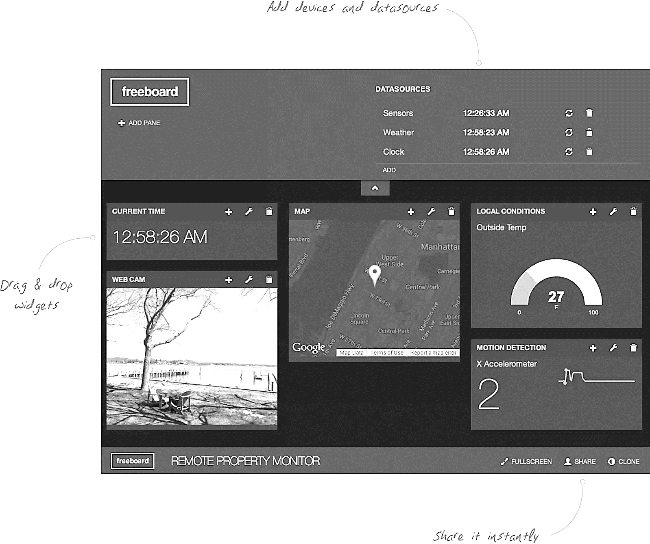
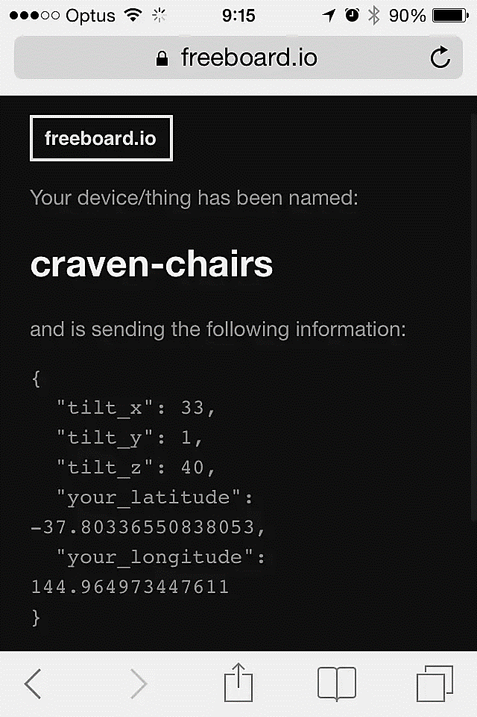
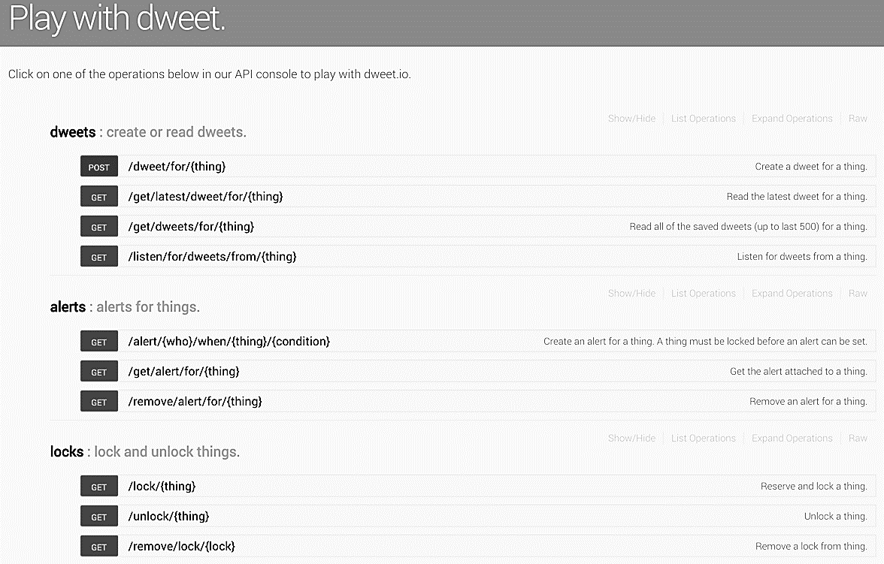
IoT Platforms Cheat Sheet – Part 2 v1.0
FreeBoard.io
Freeboard gather live “streaming” data coming from IoT devices such as from "dweets" and present them as meaningful graphs, text and gauges. It might be tracking the temperature in the home alongside its energy usage, or having a dashboard that monitors pollution around the city using GPS and air quality sensors attached to shared-bicycles.
Dweet.io
Dweet.io allows users to share data from mobile, tablets, and pcs, and them to other devices and accounts across social media platforms. Dweet.io provides an API to access the different functionality of the Dweet.io service. Users can make REST calls to read and create dweets, lock and unlock things, and perform other calls. The API returns JSON and JSONP.

Slide 7
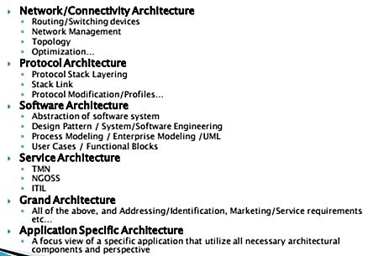
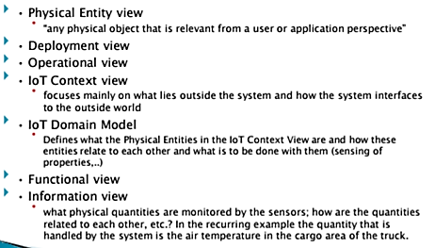
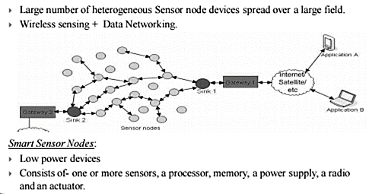
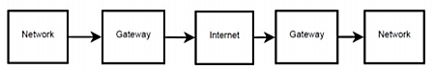
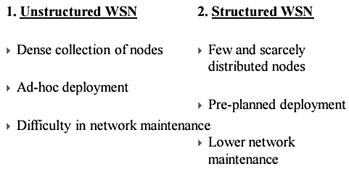
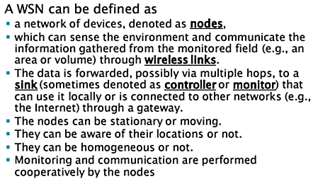
IoT Architecture Cheat Sheet v1.0
IoT Architecture Types
Architecture Model Contents
Wireless Sensor Networks
IoT-A Channel Model
Types of Wireless Sensor Networks
Transport Layer’s Main Concern
Congestion | When buffer reaches the lower threshold, the congestion bit is set with a certain probability. When buffer reaches the higher threshold, the congestion bit is set for all packets.
Reliability | Direction, reliability measure, packet recovery
Energy Conservation
Fog Computing
Definition | Architecture facilitating end-user clients or near-user edge devices (without going to the Cloud), for following tasks: storage, communication, control, configuration, measurement, management. Support IoX (Internet of Anything)
v/s Cloud Computing | Computing services at the edge of the network v/s servers in a DC, emphasizing: proximity to end-users, dense geographical distribution, local resource pooling, latency reduction for QoS, edge analytics mining, better UX, redundancy for cloud failure.
Network Layer’s Main Concern
Traffic Flow | Routing type, data aggregation, computation overhead
Energy Efficiency | Extra energy requirement

Slide 8
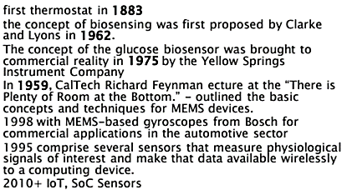
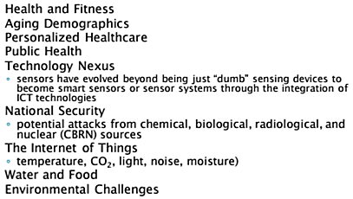
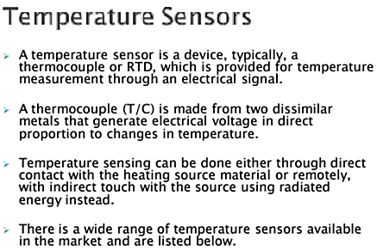
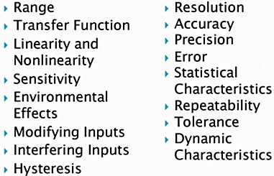
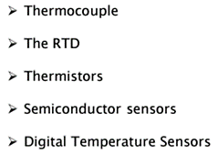
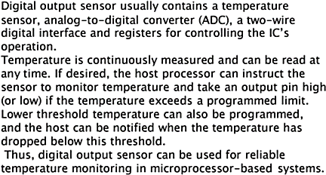
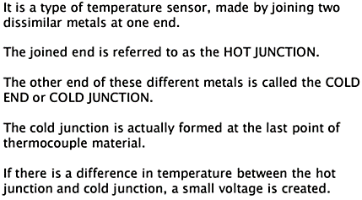
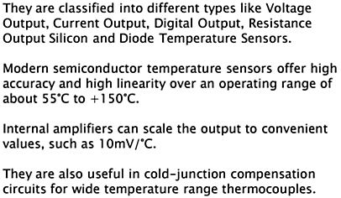
IoT Sensor Technologies Cheat Sheet v1.0
What is Sensor?
- Device that receives and responds to a signal or stimulus. - It converts stimulus / energy into electrical signals (e.g. Voltage). Note: Tranducer can also convert energy to energy (speaker) but is not a sensor.
Categories Contact v/s Contactless Motion, Environmental, Position
Product Types Camera, Microphone Radar, Accelerometer, Compass, Motion Detector Gas Detector
Sensing Attributes
Camera | Microphone | Velocity
Acceleration | Force | Strain
Light | Acoustic | Motion
Temperature | Flow | Pressure
Humidity | Chemicals
Actuator: converts electrical signal back to energy form. E.g. motor, vibrator.
Each sensor type offers different levels of: Accuracy, Sensitivity, Specificity, Ability, Cost consideration.
Mechanical Sensors | MEMS, Accelerometers, Gyroscopes
Optical Sensors | Photodetectors, IR, Fiber Optic, Interferometers
Semiconductor Sensors | Gas Sensors, Temperature Sensors, Magnetic Sensors, Optical Sensors, Ion-Sensitive Field-Effect Transistors
Electrochemical Sensors | Potentiometric Sensors, Amperometric Sensors, Coulometric, Conductometric Sensors
Biosensors | Transducers for Biosensors, Key Characteristics of Biosensors
Sensor History
Drivers for Sensor Applications
Temperature Sensors
Sensor Characteristics
Digital Temperature Sensors
Thermocouple
Semiconductor Sensors
Sensor Characteristics Detail P2
Accuracy | Sensor’s ability to provide an output close to the true value of the measurand.
Precision | The reproducibility of a measure, quantified as % of std deviation from the mean.
Errors | Systematic Errors, Random Errors (Noise), Error Bands
Repeatability | Ability to produce the same output when the same input is given.
Tolerance | The variations in the reported output among a batch of similar elements due to random manufacturing variations.
Sensor Characteristics Detail
Sensitivity | Is the change in input required to generate a unit change in output.
Hyteresis | Output of a sensor may be different for a given input, depending on whether the input is increasing or decreasing.
Resolution | Discrimination, or the smallest increment of measurand that causes a detectable change in output.
Sensor Characteristics Detail P3
Response Time | Time taken for the sensor to change its output from its previous state

Slide 9
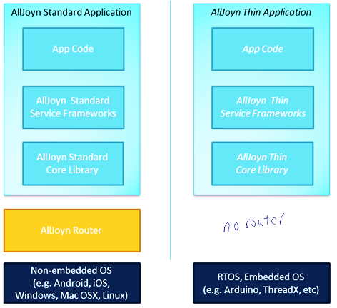
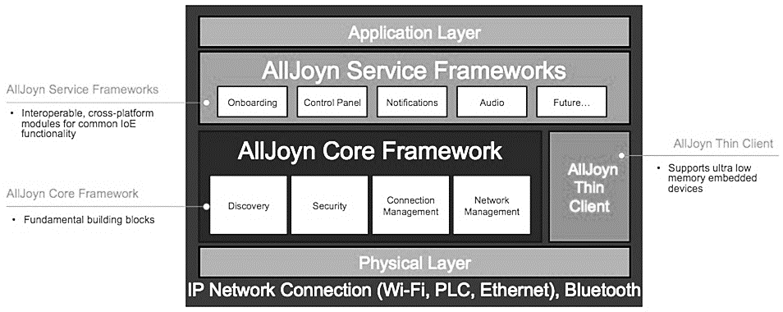
IoT Framework Cheat Sheet – Part 1 v1.0
Major IoT Standards
AllSeen | Dec-2013 Microsoft, Qualcomm, Cisco, LG, Panasonic, Sharp, Haier, Electrolux
Thread | Jul-2014 ARM, Big Ass Fans, Freescale, Nest, Samsung, Silicon Labs, Yale
Open Interconnect Consortium (OIC) | 2014 Atmel, Broadcom, Dell, Samsung, Intel, Wind River
Industrial Internet Consortium (IIC) | 2014 AT&T, Cisco, GE, IBM, Intel, Wind River
AllJoyn Framework
AllJoyn is a collaborative open-source software framework that makes it easy for developers to write applications that can discover nearby devices, and communicate with each other directly regardless of brands, categories, transports, and OSes without the need of the cloud (the framework runs on the local network and does not require the cloud to function).
Transports | Wi-Fi, Ethernet, Serial, PLC, via a Gateway Agent (AllJoyn service)
Bindings | C, C++, Obj-C, Java
Platforms | RTOS, Arduino, Linux, Android, iOS, Windows, Mac, OpenWRT, Unity plug-in
Security | peer-to-peer encryption (AES128) and authentication (PSK, ECDSA)
Configurations | In XML format
AllJoyn Architecture
AllJoyn framework comprises: - AllJoyn Apps, and AllJoyn Routers. - App talks to Router and vice versa, App can’t talk to App.
Bundled Router | App uses its own Router, usually Android, iOS, Windows, or OSX apps.
Standalone Router | Multiple apps on the same device share one Router.
“Remote” Router | App uses Router on a different device, usually apply for embedded devices with little or no resource.
Core Framework
Advertisement and Discovery
About Announcement | Recommended mechanism for advertising, provide set of metadata about the application.
Well-known Name | A more primitive mechanism for announce and discover of applications, used by About Announcement.
Session and Port After discovery process happens, connection is created using Session and Port. A session can be either point to point or multi-point. It is created on specific port.
Bus Attachment Mediate all connection to AllJoyn bus.
Bus Object Is attached to a specific bus path (same object can be on different bus paths), implements a set of interfaces, allows a remote entity to call a method on local application.
ProxyBusObject A symmetrical object to Bus Object, created by remote application to gain access to the BusObject.
Sessionless Signal A mechanism to receive signals w/o having to manually create a session.
Instropection To discover a remote AllJoyn application about its objects and object paths, full interface: methods, params, properties, and signals.
Events and Actions To describe its signals and methods accordingly
Security Occurs at the application level, as there is no trust at the device level. Using PIN code, PSK, or ECDSA. Message are encrypted with AES-128 CMM
The AllJoyn Session
The AllJoyn requires “from” and “to” information to form a session.
TO Correspond to the targeted service | {session options, bus name, session port} - session options: how the data is exchanged, i.e. TCP or UDP. - bus name: the well-known name of corresponding bus attachment - session port: point of delivery “inside” the bus attachment. Eg., {reliable IP messages, org.alljoyn.samples.chat.a, 42}
FROM Correspond to the location of the client component | {session options, unique name, session ID} - unique name: the client’s unique name - session ID: the client is assigned an ID when the connection is established. Eg., {reliable IP messages, org.alljoyn.samples.chat.a, :2.1, 1025}
AllJoyn Core Library | Lowest level APIs to interact with AllJoyn network, such as Security, Network, Session, Messaging / Routing
AllJoyn Service Framework | Implements a set of common services, like onboarding, notification, configuration, or control panel.
AllJoyn App Code | Application logic, can access both Service Framework or Core APIs.

Slide 10
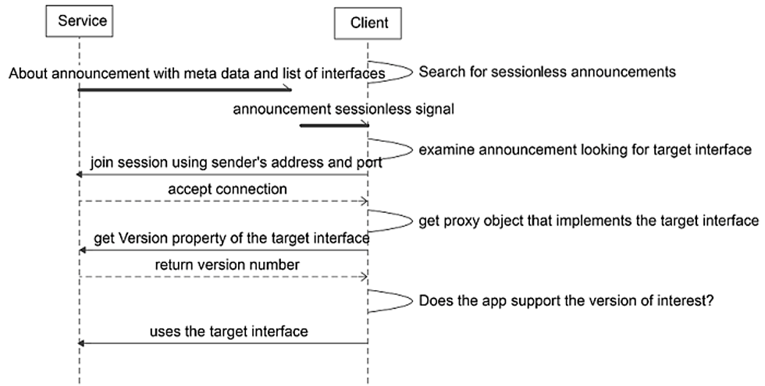
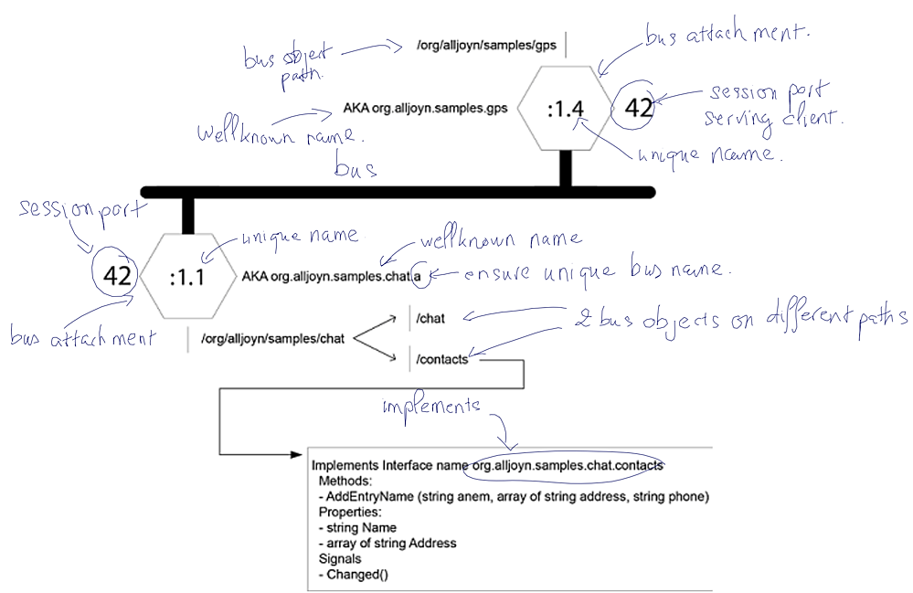
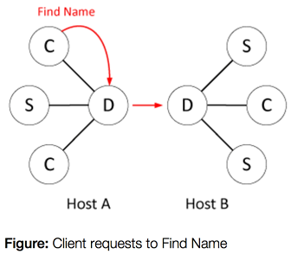
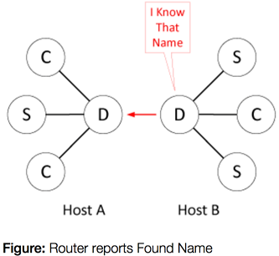
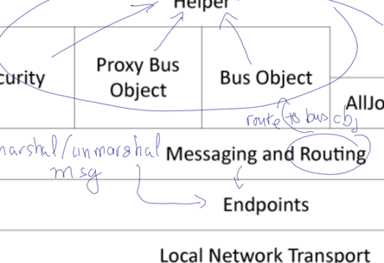
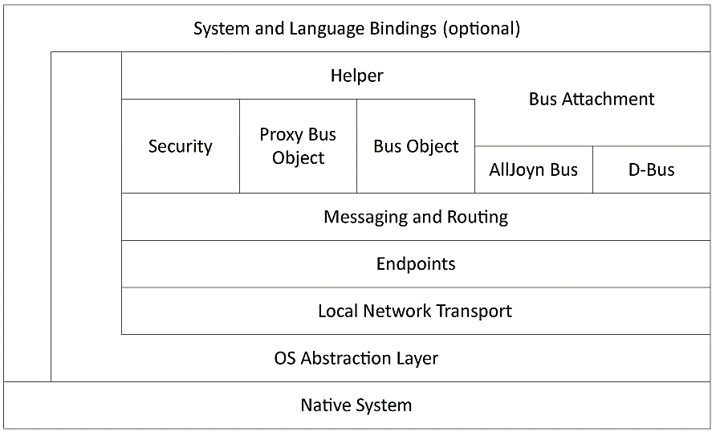
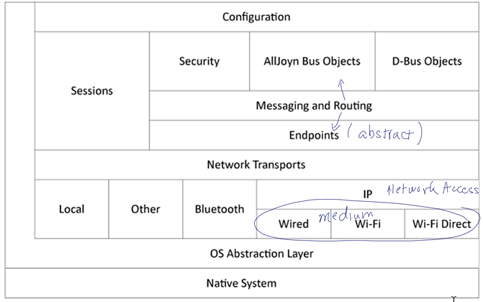
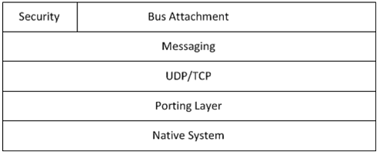
IoT Framework Cheat Sheet – Part 2 v1.0
Discovery Call Flows
Bus and Bus Attachment
AllJoyn Standard Core Library Layering
AllJoyn Standard Core Library Router Layering
AllJoyn Thin Core Library Layering

Slide 11
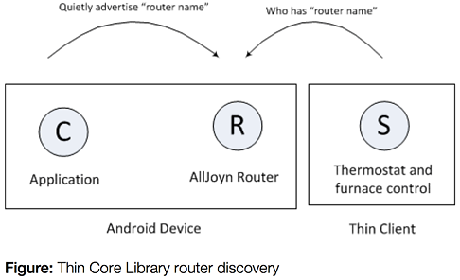
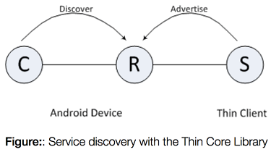
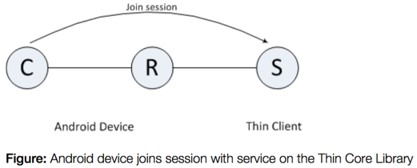
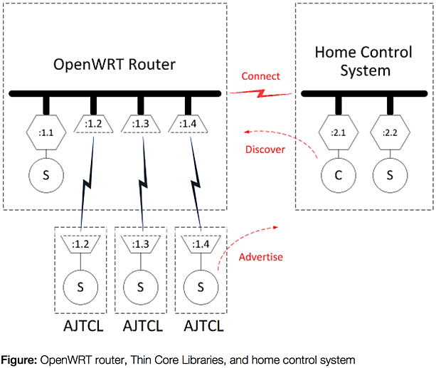
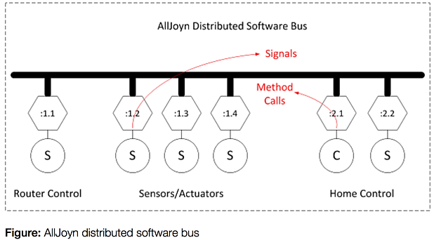
IoT Framework Cheat Sheet – Part 3 v1.0

Slide 12
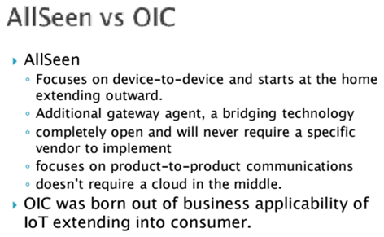
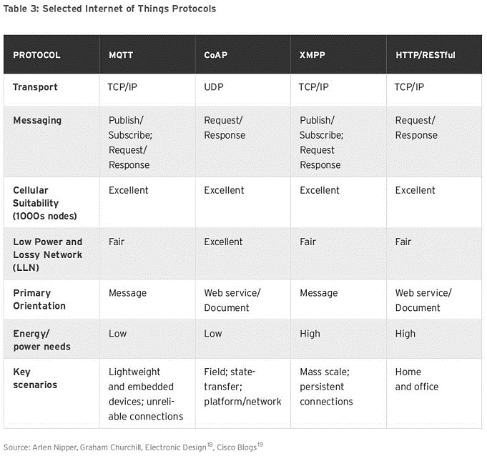
IoT Framework Cheat Sheet – Part 4 v1.0

Slide 13
IoT Misc – Part 1 v1.0
IoT and Bluetooth related RFCs
7668 | IPv6 over BLUETOOTH(R) Low Energy
4944 | Transmission of IPv6 Packets over IEEE 802.15.4 Networks
6282 | Compression Format for IPv6 Datagrams over IEEE 802.15.4-Based Networks
6775 | Neighbor Discovery Optimization for IPv6 over Low-Power Wireless Personal Area Networks (6LoWPANs)
6574 | Report from the Smart Object Workshop
7228 | Terminology for Constrained-Node Networks
7390 | Group Communication for the Constrained Application Protocol (CoAP)
7400 | 6LoWPAN-GHC: Generic Header Compression for IPv6 over Low-Power Wireless Personal Area Networks (6LoWPANs)
7554 | Using IEEE 802.15.4e Time-Slotted Channel Hopping (TSCH) in the Internet of Things (IoT): Problem Statement
7641 | Observing Resources in the Constrained Application Protocol (CoAP)
802 | Overview | Description
802.3 | Ethernet | "Grandaddy" of the 802 specifications.
802.15 | Wireless Personal Area Networks | Communications specification that was approved in early 2002 by the IEEE for wireless personal area networks (WPANs).
802.15.1 | Bluetooth | Short range (10m) wireless technology for cordless mouse, keyboard, and hands-free headset at 2.4 GHz.
 | ATtiny2313 | ATtiny84 | ATtiny85 | ATmega328 | ATmega2560
Cost | $3.13 | $3.53 | $2.65 | $3.70 | $16.75
Pin Count | 20 | 14 | 8 | 32 | 100
Max IO pins | 18 | 12 | 6 | 23 | 86
Flash Memory | 2 Kb | 8 Kb | 8 Kb | 32 Kb | 256 Kb
EEPROM | 128 bytes | 512 bytes | 512 bytes | 1 Kb | 4 Kb
ADC channels | 0 | 8 | 4 | 6 (8 on SMD) | 16
PWM channels | 4 | 4 | 6 | 6 | 15
Timers | 1 8bit 1 16bit | 1 8bit 1 16bit | 2 8bit | 2 8bit 1 16bit | 2 8bit 4 16bit
SRAM | 128 bytes | 512 bytes | 512 bytes | 2 Kb | 8 Kb
Hardware Serial | No | No | No | Yes – 1 | Yes – 4
Hardware I2C | No | No | No | Yes | Yes
External Interrupts | 2 (8 PCINT) | 1 (12PCINT) | 1 (6 PCINT) | 2 (23 PCINT) | 8 (32 PCINT)

